Slide 1
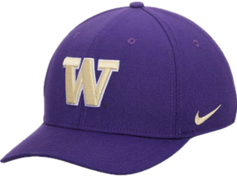

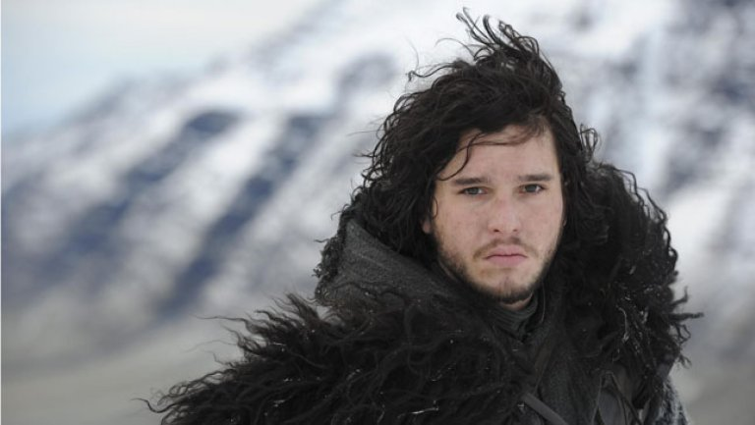
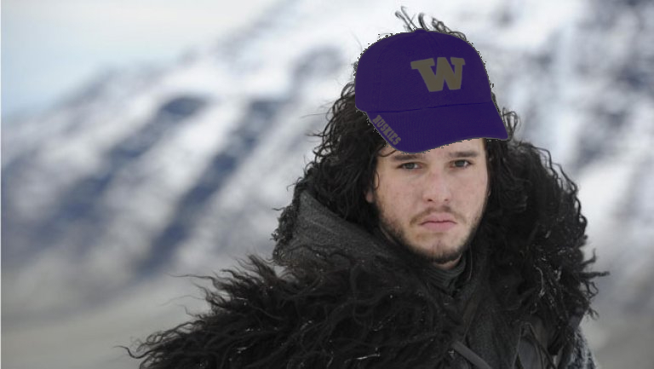
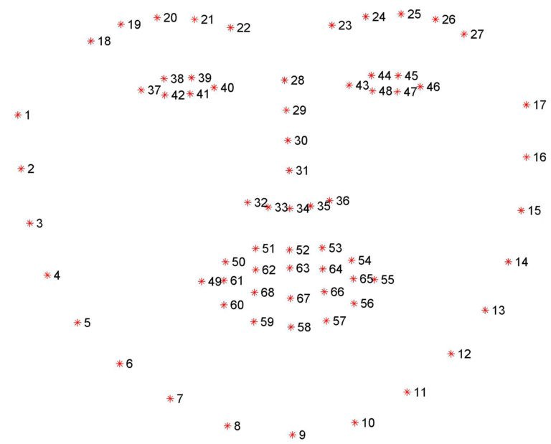
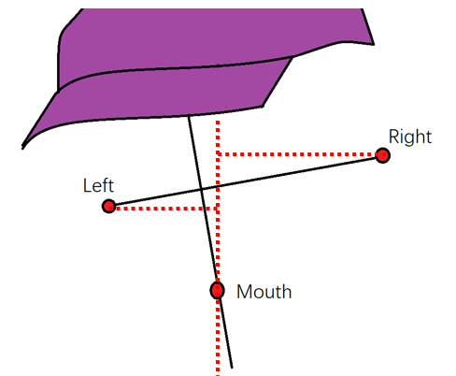

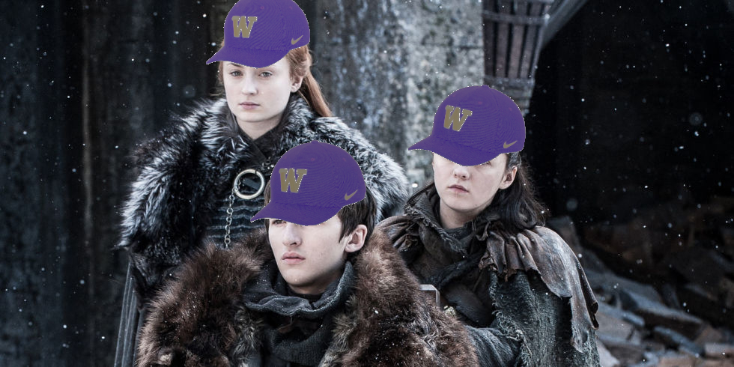
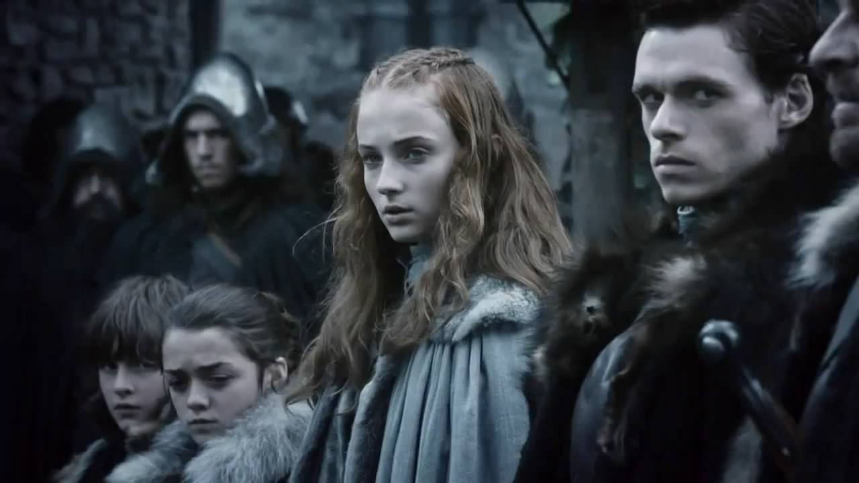
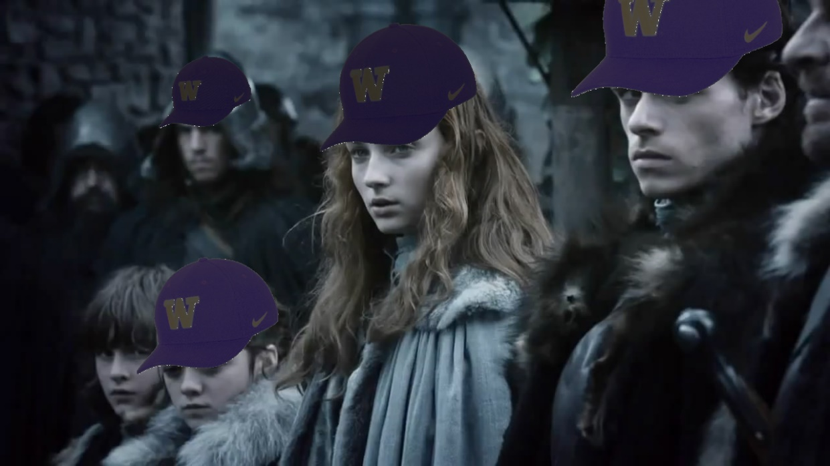

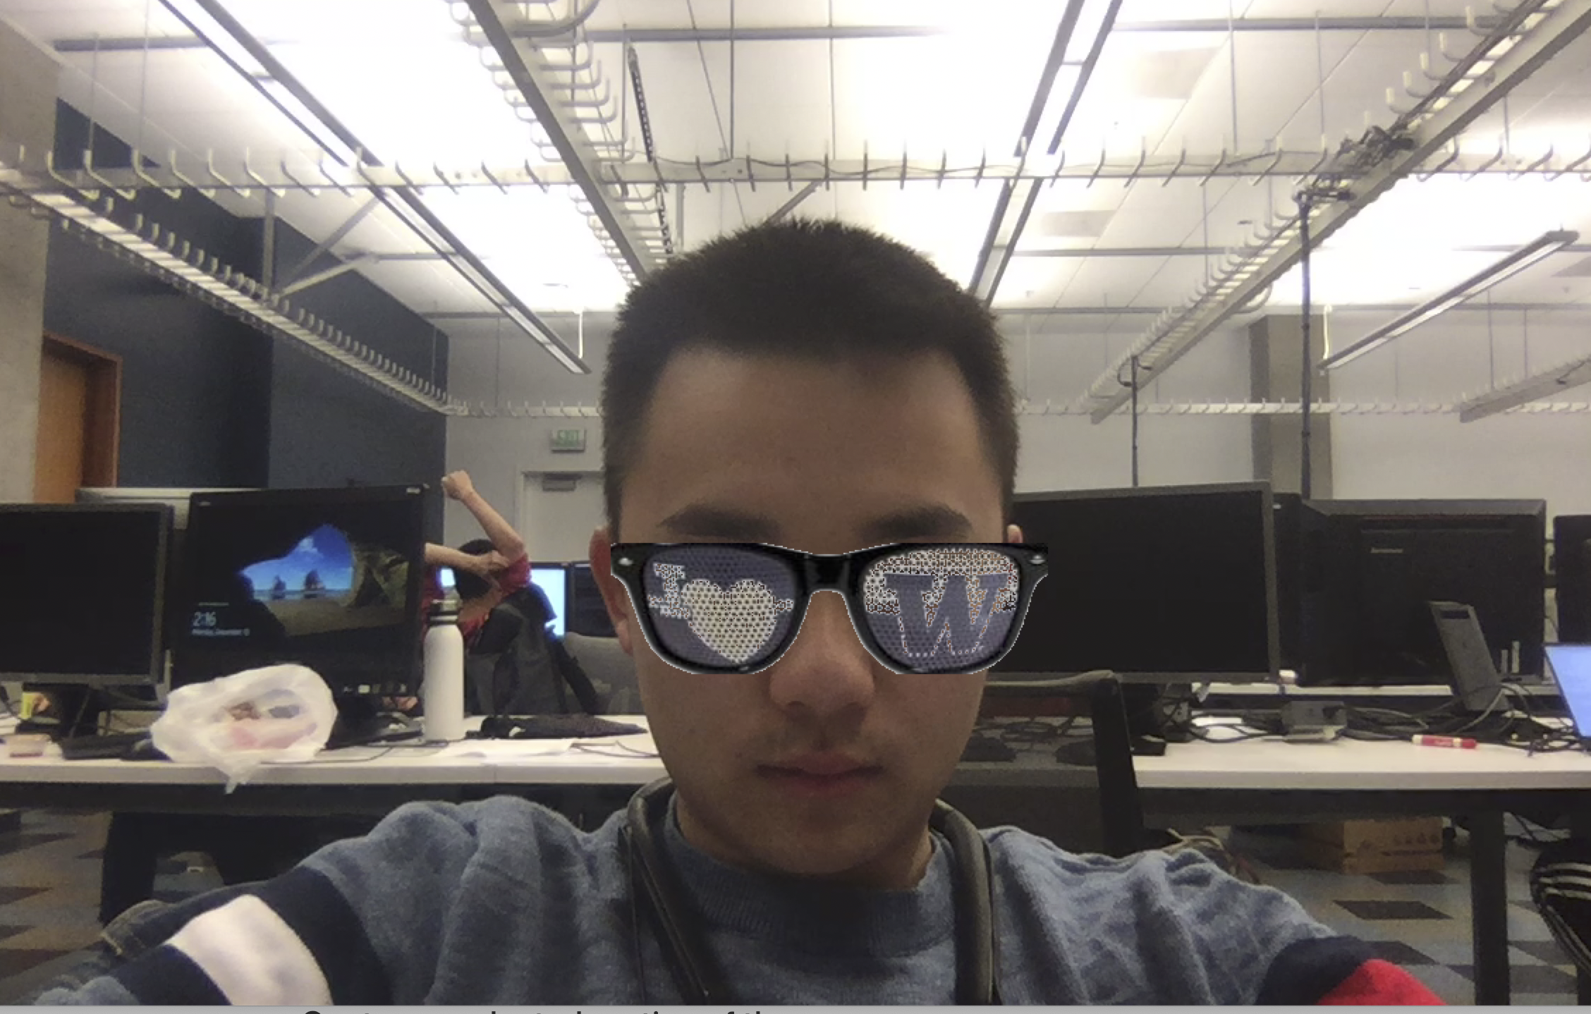
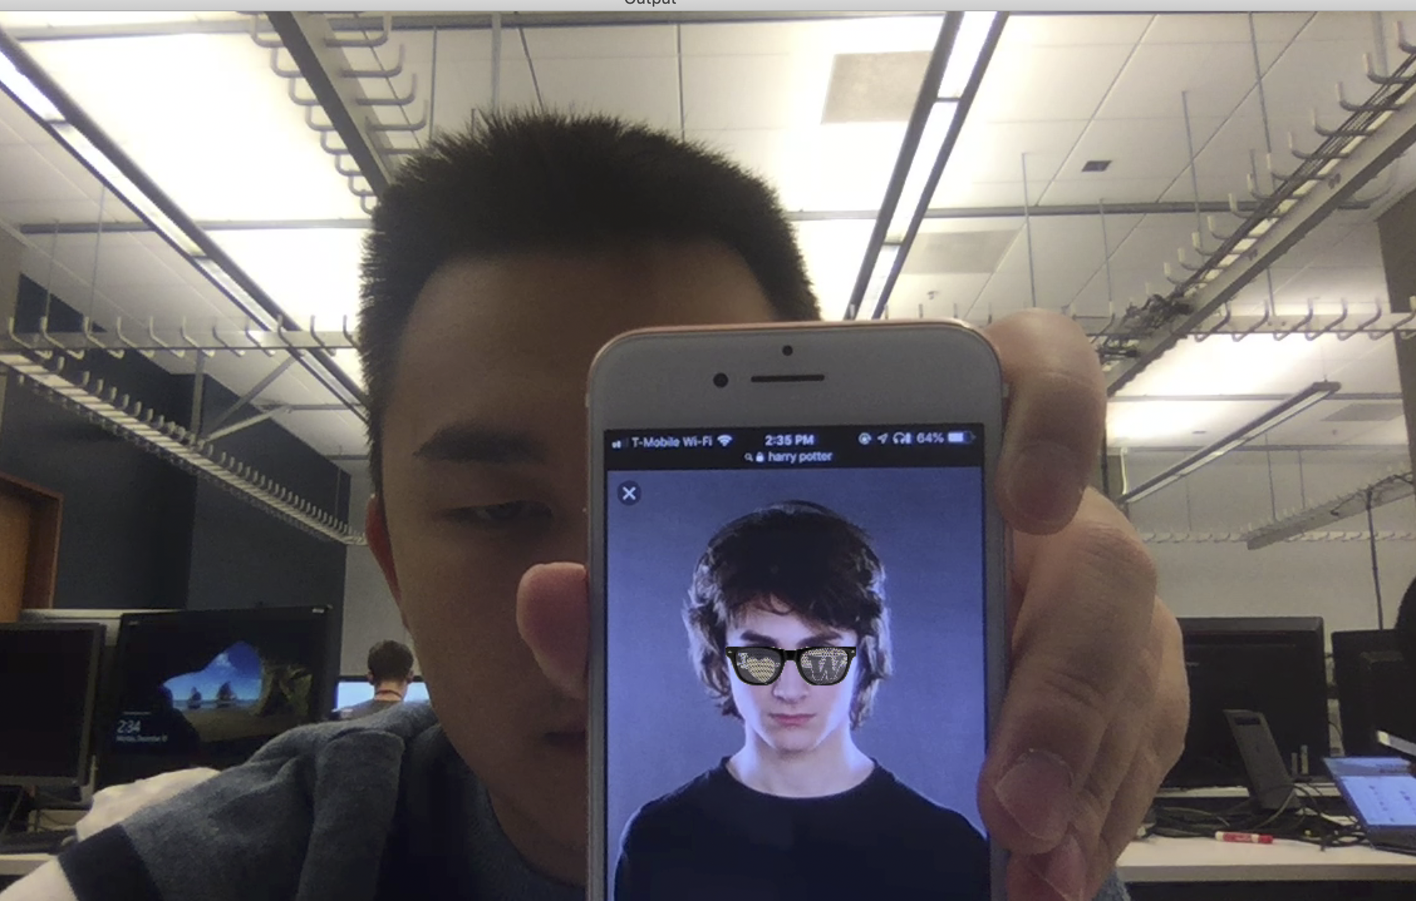

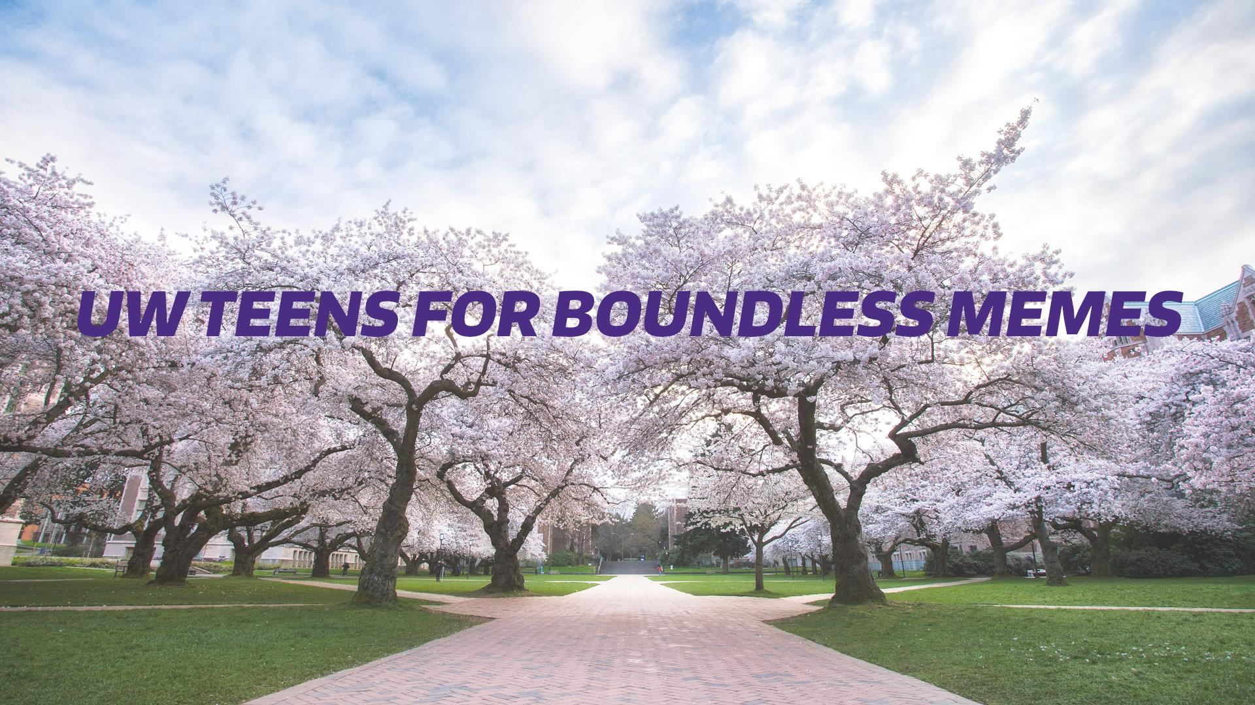
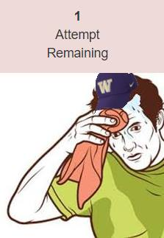
MemeDub
Matt Xu, Michael Fang, Andrew Wei | Computer Vision CSE455 Autumn 2018 | University of Washington
Abstract
Model
Results
We put UW hats and glasses on faces for both images and videos in real time like a “Snapchat” filter
We did this using a mix of facial feature recognition and math
We’re using a pre-trained model that was trained on the iBUG300-W dataset
W opted to use a pre-trained model because we have finals and couldn’t find the time to train the model ourselves
Images
Before
After
Process
General:
We used OpenCV, dlib, and the model to detect and obtain the features of faces
Image:
We firstly use the horizontal relative location to determine where the hat should be pointing towards and which hat exactly should be put on. Then we calculate the size of the face and figure out the proper size of a hat using some expansion parameter. As for resizing we used the bilinear resizing method we implemented before. Using the tilting angle calculated during the face size calculation, we can figure out the rotation angle of the hat and rotate it using our own rotation method. After that, we analyze the pixel value at the three points to gain the brightness suitable for the hat by temporarily converting the image from RGB to HSV and extracting the Value using the image processing library we implemented during this quarter. Then we use the three locations and some tuned parameters to figure out the center of the hat, and we draw the hat on it.
Video: (Extra feature)
We used our webcam and detected faces from each frame and overlaid glasses where the faces were. However, this presents more challenges since we need to resize the glasses and rotate them in each frame. Moreover, due to the angle that a person looks at the camera, the glasses should be represented in the same angle as well. 3-D constructing such glasses would be optimal but we don’t have time to do so
Inspiration
Video
References
Facial mapping (landmarks) with Dlib + python by Italo José
C image processor by UW Computer Vision Course of Autumn 2018
UW Teens for Boundless Memes

